Slide 1


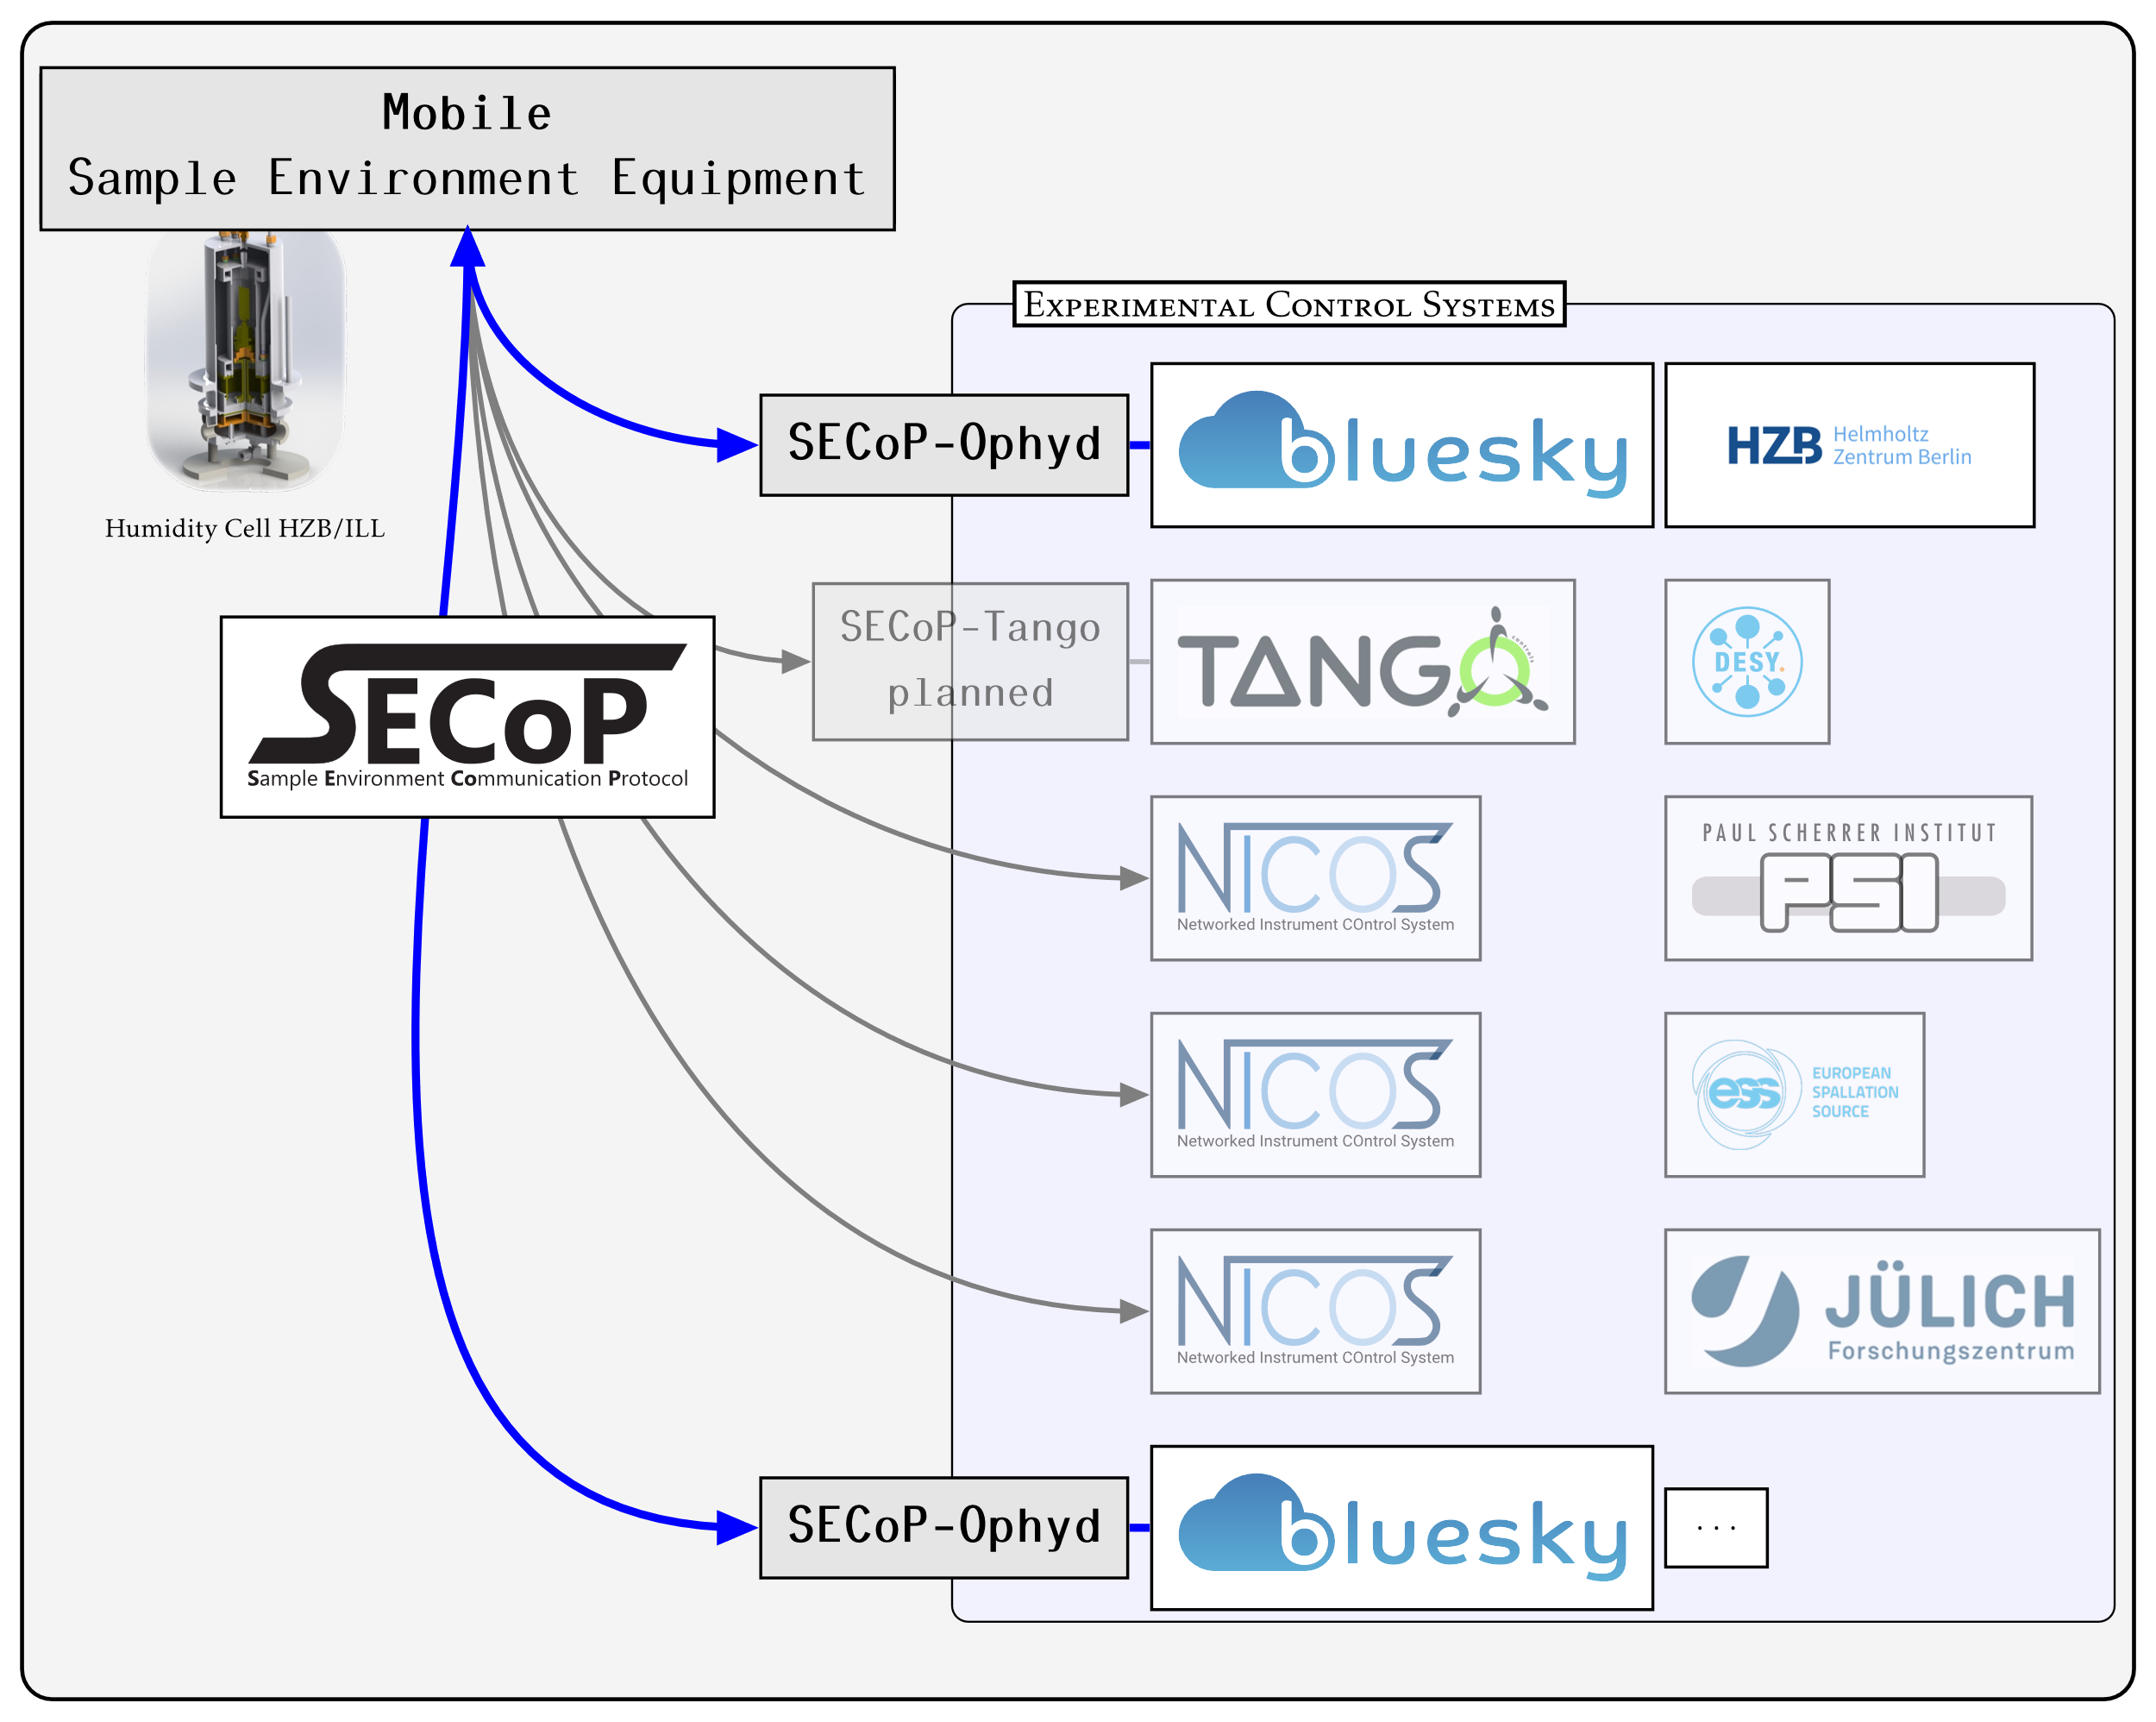
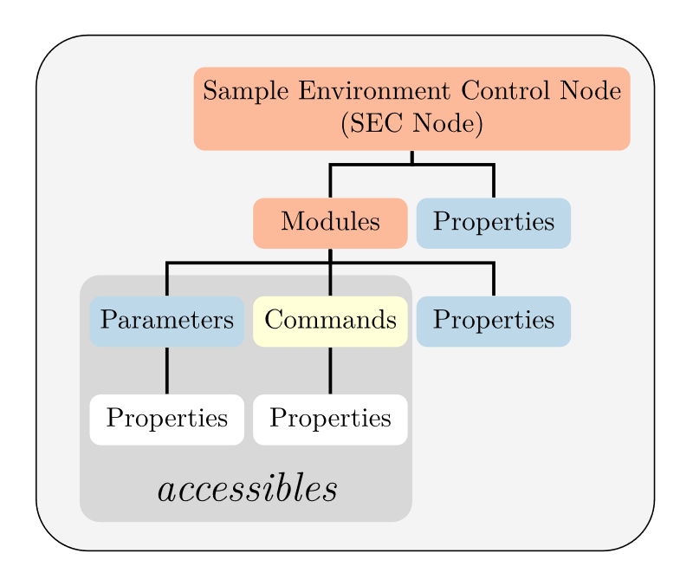
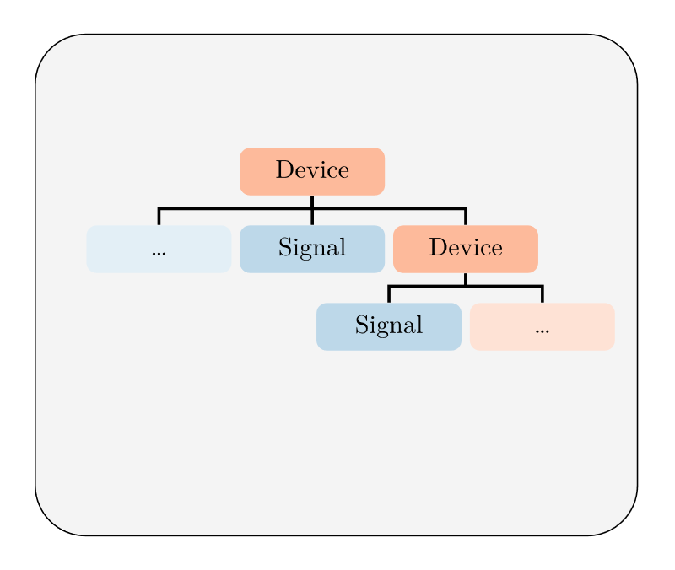
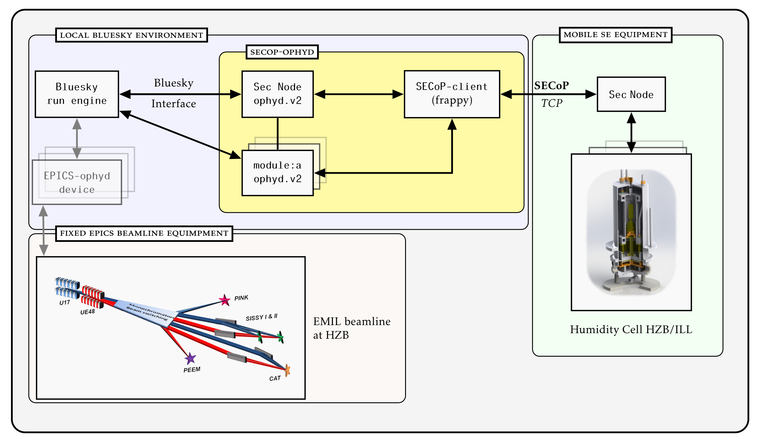












Secop Integration for the ophyd hardware abstraction layer
P. Wegmannª, K. Kieferª, W. Smithª, L. W. Rossaª, O. Mannixª, M. Zolliker^{b} and E. Faulhaber^{c}
ªHelmholtz-Zentrum Berlin, Hahn-Meitner-Platz 1, 14109 Berlin, Germany - ^{b}Paul Scherrer Institut, Forschungsstrasse 111, 5232 Villigen, Switzerland -
^{c}Forschungs-Neutronenquelle Heinz Maier-Leibnitz, Lichtenbergstraße 1, 85748 Garching, Germany
At the core of the Bluesky experimental control ecosystem the ophyd hardware abstraction, a consistent high-level interface layer, is extremely powerful for complex device integration. It introduces the device data model to EPICS and eases integration of alien control protocols. This paper focuses on the integration of the Sample Environment Communication Protocol (SECoP) into the ophyd layer, enabling seamless incorporation of sample environment hardware into beamline experiments at photon and neutron sources. The SECoP integration was designed to have a simple interface and provide plug-and-play functionality while preserving all metadata and structural information about the controlled hardware. Leveraging the self-describing characteristics of SECoP, automatic generation and configuration of ophyd devices is facilitated upon connecting to a Sample Environment Control (SEC) node. This work builds upon a modified SECoP -client provided by the Frappy framework, intended for programming SEC nodes with a SECoP interface. This paper presents an overview of the architecture and implementation of the secop-ophyd integration and includes examples for better understanding.
Fully functional ophyd.v2 Devices are generated automatically
All metadata published by SEC Node is preserved
Concurrent operation with ophyd.v1
Concurrent operation wihth other ophyd devices backed by other control systems like EPICS
Simple interface:
SECoP_Node_Device.create(
host: str, # SEC Node IP
port: str, # SEC Node Port
loop): # Eventloop
Source available at:
Figure 3: SEC Node structure
Figure 4: Ophyd Device structure
Structural Correspondences
Interface Correspondences
Parameter,
SEC Node Property, Module Property
Signal
SECoP interface class
Ophyd mixins
SEC Node,
Module
Device
Drivable
Movable
Figure 1: Moving and integrating sample environment equipment between research facilities, with differing experimental control systems
Readable
Readable
Architecture
Commands
Sub-Device
ophyd.v2 API
Add further optiona features supported by Bluesky
Investigate if Ophyd Devices generated by the SECoP-Ophyd integration are compatible with the Nexus Format
Apply the concept to real use cases at at beamlines where an existing Bulesky environment is running
Python asyncio framework
Concsice and clear interface for the backend
Frappy-client had to be wrapped to work with asyncio framework
API is not yet officially released, but reasonably stable
INTERESTED?
Contact the SECoP working group
Get started with SECoP
Figure 2: Architecture overview of how the SECoP-Ophyd integration interfaces with the Bluesky run engine and a SEC Node.
Partners
More Information
An introduction to SECoP
[1] K. Kiefer, et al. (2020). An introduction to SECoP – the sample environment communication protocol. Journal of Neutron Research, 21(3-4), pp.181–195
https://doi.org/10.3233/jnr-190143
SECoP on GitHub
https://github.com/SampleEnvironment/SECoP
International Society for Sample Environment (ISSE)
https://sampleenvironment.org/
Helmholtz Metadata Collaboration:
https://helmholtz-metadaten.de/de
Peter Wegmann
peter.wegmann@helmholtz-berlin.de
Helmholtz-Zentrum Berlin für Materialien und Energie
Hahn-Meitner-Platz 1
14109 Berlin, Germany
The project SECoP@HMC is part of the HMC project cohort 2021
and receives funding by the
Initiative and Networking Fund (INF) of the Helmholtz Association

